Slide 1
Delivery On Foot
Capstone Project
Team Members:
Mandeep Kaur (C0684262)
Fahad Shaikh (C0686094)
Sahil Thapar (C0688032)

Slide 2
Why DOF?
Isn’t it frustrating to wait for days just for a small package or documents that are coming from just the other part of the city?

Slide 3
Introduction
The basic idea of the app is to provide same-day delivery service at an affordable price for a city.
Customers can send and receive items across the city.
Customer can act as Poster and Bidder.
Customer as a Poster can post a listing which will have item’s name, description, value, pick-up/delivery address & time etc.
Customer as a Runners will see this listing on their phone and bid for it.

Slide 4
Target Platform and Audience
Target platform for app is Android.
Reason for choosing this platform is that the target audience we are focusing on usually comes from middle class communities and they tend to own an android device rather than an iPhone.
The targeted users are people from the local area of city who want to send or receive items on the same day.
We will also target on people who are looking for part-time work opportunity and willing to deliver items across the city and earn some extra cash.

Slide 5
Benefits
For Customers:
Same-day affordable delivery.
Reliable and efficient service.
Choose their own price.
For Runners:
Part-time work opportunity.
Can work on their own schedule.
Bid with other users and ask for their own wage.

Slide 6
Basic App Requirements
Requires Customers and Runners personal information (Name, Phone Number, Email, Address).
Needs access to location service.
Requires payment credentials from both parties.
Requires Camera access for posting delivery item image.

Slide 7
Monetization Methods
Service Fees Incurment : We incur a minor Service fee of 5% on the amount of accepted bid by the customer who added the listing and they are charged with total amount of the accepted bid plus the service fee. Example:
Accepted Bid: $50
Service Fee: 5%
Total Amount charged: $50 + 5% (50) = $ 52.5

Slide 8
Monetization Methods (continue)
We also plan to introduce mobile advertising using the Google AdMob service where users are shown ads based on their location and search history.
Mobile advertising will generate a substantial amount of revenue for the application and hence ensuring continuous operations of the the company as well as bringing in profits for the company and its stakeholders.

Slide 9

App Walkthrough

Slide 10
Login Screen

Slide 11
Sign up Screen

Slide 12
My Listing Screen (Poster Specific)

Slide 13
Bids Screen

Slide 14
Add New Listing

Slide 15
Listing View

Slide 16
Bids Accepted

Slide 17
Bid Acceptance

Slide 18
Bids Screen (Runner Specific)

Slide 19
Bid Interface

Slide 20
Payment Detail Request

Slide 21
Bids received in Customer’s Listing

Slide 22
Bid Acceptance Message

Slide 23
Other Settings

Slide 24
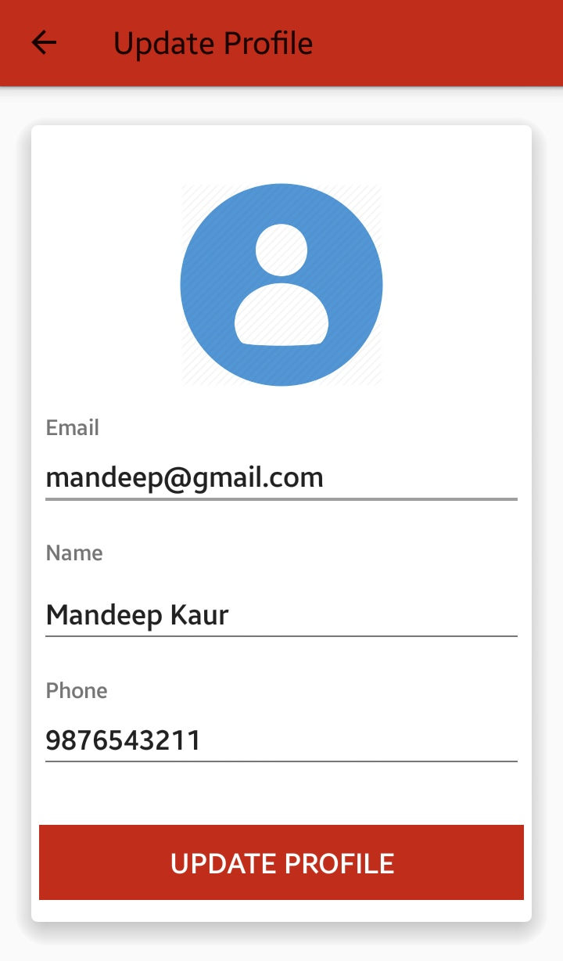
Update Profile

Slide 25
Change Password

Slide 26
Customer Support Facility

Slide 27
Thank You
Team DOF ☺

